Slide 1
Architecture of Network Rail data Ingestion &ETL
With AWS Services

Slide 2
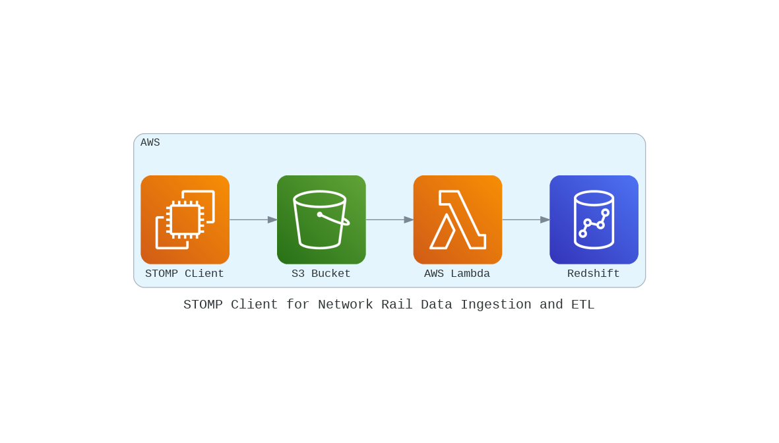
Architecture of Network Rail data Ingestion &ETL

